Slide 1
Menopause and the Dental workforce
Suzanne Banks CBE,
Clinical Programme Lead,
NHS England Menopause Programme

Slide 2
Growing profile in the media
Recognition by Government
Key part of first England Women’s Health Strategy
NHS England developing what we need to do
Similar in Scotland, Wales and NI

Slide 3
Menopause
Facts about the menopause and the perimenopause
Menopause is defined as having occurred when a woman has not had a period for 12 continuous months (for women reaching menopause naturally and not on oral contraception)
Symptoms can appear years before periods stop, as the body makes its changes leading up to the menopause (the ‘perimenopause’ or ‘menopause transition’)
Symptoms may continue long after the menopause. This time of life is known as the ‘post-menopause’
The menopause is the time when a woman stops having periods and can no longer get pregnant naturally. The ovaries stop releasing eggs and no longer produce the hormones oestrogen and progesterone.
Notes:
For 94% women the menopause occurs between the age of 45 and 55 with the average age being 51
5% occurs between 40 and 45 and known as early menopause
1% before 40 and known as premature menopause
Surgical menopause can be brought on at any stage

Slide 4
Menopause timeline
A typical menopause timeline | Menopause 12 months after your periods stop
Regular periods | Perimenopause Change in periods, menopausal symptoms | Postmenopause No further periods, symptoms may persist
12 months
Last period
This does not apply to all women e.g. those who are not having periods due to certain types of contraception, or who have had a hysterectomy, when symptoms are used to make the diagnosis.
Notes:
To help clarify this we have included a graphic of a typical menopause timeline. Again the start of the clarification that it applies to somebody having regular periods. You see we have three eras - regular periods, perimenopause and postmenopause.
The last Period is marked in the perimenopause section but it is a further 12 months before we know it was the last period. So, although technically, menopause is The point at which periods stop, we can't make that diagnosis and 12 months later. These 12 months are still within the perimenopause.
Thereafter it's the post menopause symptoms can still continue for many years.

Slide 5
Evidence on women’s knowledge and experiences
Menopause is a stage of life experienced in different ways
(Hoga, Rodolpho et al. 2015)
Personal & tailored healthcare according to needs, preferences & expectations
Characterized by personal challenges, changes in personal roles within the family and society
Women’s approaches influenced by their personal, family and sociocultural background
Hot flushes and night sweats strongest symptoms
Health care providers pay little attention to women's perceptions regarding menopause
Literature review about women's knowledge & experience of peri/ menopause: (O'Reilly, McDermid et al. 2022)
Knowledge of peri / menopause varies significantly globally and within countries
Experience of peri/ menopause is heterogenous and influenced by deeply embedded sociocultural patterns.
Individualised support during peri/ menopause to meet diverse needs

Slide 6
How is the menopause understood?
Without knowledge or training, menopause is usually assumed as follows:
Applies to mature/old women having ‘hot flushes’
Grumpiness
Moodiness
‘the Change’
It largely isn’t well understood ..
Good menopause care plays a key role in supporting and retaining the dental workforce.

Slide 7
Context
Women make up 51% of the population
On average, c.400,000 women start the menopause transition each year.
Menopause affects most women between the ages of 45 and 55 years
Average age of onset is 51, so many women therefore enter the menopause at the peak of their productive lives, with an increasing number going through the menopause whilst working
Approximately 1% of women will experience premature menopause (before 40)
Approximately 5% of women will experience the menopause early (40 – 45)
Surgical menopause can happen at any age
Menopause symptoms usually start a few months or years before periods stop (perimenopause) and can continue for some time afterwards. Symptoms of the perimenopause and menopause are wide ranging and can impact women both physically and psychologically

Slide 8
Context continued
1 in 10 women leave their job, when they don’t want to, because of poor menopause support and healthcare provision. (Fawcett national study)
3 in 5 women experiencing the menopause believe their symptoms have a negative impact on them at work and 1 in 3 said they had been unable to go into work because of their menopause symptoms
Support and understanding from managers and colleagues in the workplace is crucial and can make a huge difference to how a women deals with her menopause at work
Looking after and supporting women going through the menopause is key for organisations in order to retain and value your staff
Good menopause care has both direct and indirect impacts on workforce retention and productivity, and ensuring staff get the support they need is an important part of retaining experienced talent and skills

Slide 9
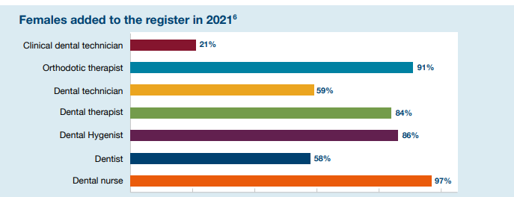
Female Dentists & Dental Professionals
88,633 people, 77.2% of the workforce are women
Notes:
58% of Dentists are female
97% of Dental nurses are female
21% of clinical dental technicians are female

Slide 10
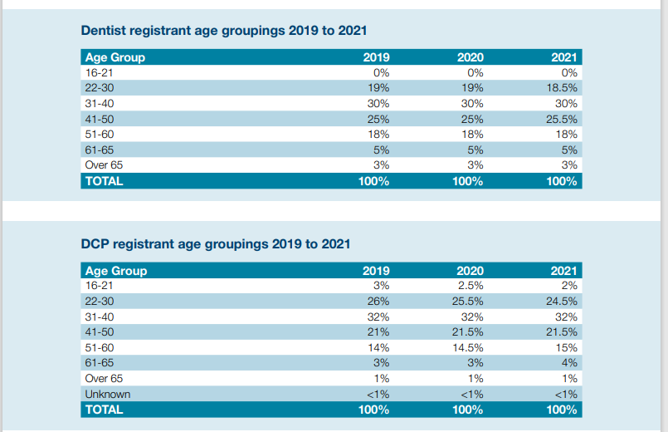
Dentists & Dental Professionals Age Groups
Perimenopause and menopause usually occur between the ages 45 and 55 years of age.
In the UK, the average age for a woman to reach menopause is 51.
Just under 50% (43.5%) of Dentists fall into the 41 to 60 age range.

Slide 11
What are some of the common symptoms of the menopause?
Changes to periods
Hot flush and Night sweats
Sleep disturbance
Anxiety and feeling low
Reduced concentration
Memory loss and Brain fog
Reduced confidence
Vaginal discomfort and UTI’s

Slide 12
25% will not get symptoms
Around 75% of women will get symptoms
25% of women will get severe or bothersome symptoms
Symptoms during perimenopause, menopause and post-menopause
Notes:
For many women menopausal symptoms are mild and can be managed without specific treatment
For others they can have a major impact on their lives and affect their relationships and work
Symptoms may continue long after women reach the menopause

Slide 13
Self Care
General tips to help with menopause symptoms
Lifestyle changes and self care can help you during the perimenopause and menopause whether or not you are using HRT
Make sure you:
Rest when you need to
Eat a healthy diet
Maintain a healthy weight
Take physical exercise regularly
Find time to relax
Cut down on alcohol
Share with other people going through the menopause
If you smoke, talk to your pharmacist or GP practice about an NHS stopping smoking programme

Slide 14
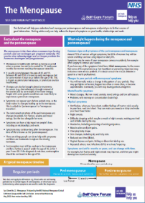
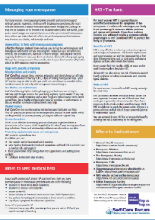
Menopause Self Care Fact Sheet
https://www.selfcareforum.org/menopause
Menopause and symptoms
Facts about the menopause
A typical menopause timeline
What might happen during the (peri-) menopause?
Managing the Menopause
HRT The facts
When to seek medical help
Where to find out more

Slide 15
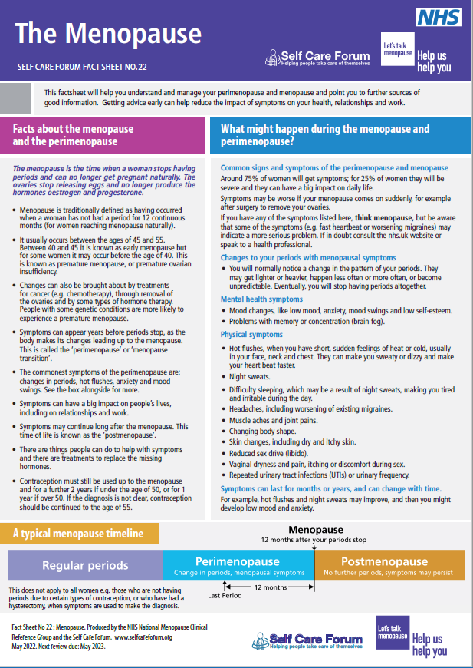
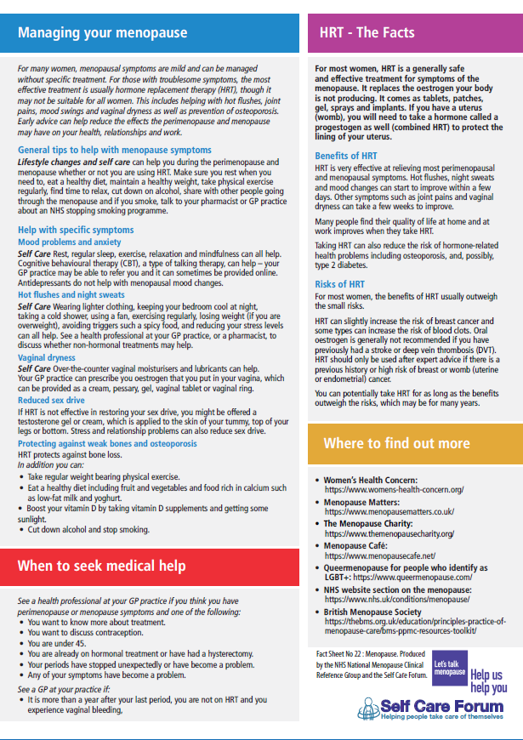
NHS Menopause
Group
factsheet
https://www.selfcareforum.org/wp-content/uploads/2022/05/22-Menopause-factsheet.pdf

Slide 16
Potential impact on quality of working life and performance if support is not readily available:
Potential impact if support is not readily available
Reduced engagement with work
Reduced motivation
Reduced job satisfaction
Reduced commitment to the organisation
Increase in sickness absence
Increase in desire to leave work altogether

Slide 17
National Context
Menstrual health and gynecological conditions
Fertility, pregnancy, pregnancy loss and post-natal support
Menopause
Mental health and wellbeing
Cancers
Women’s Health Strategy for England- 7 priority areas
The health impacts of violence against women and girls
Healthy ageing and long-term conditions

Slide 18
Overview of NHS England Menopause Improvement Programme
The 4 key areas that the programme will focus on and the potential effects on Primary care are as follows:
Clinical Optimal Pathway: The Menopause CRG is defining the Optimal treatment pathways for patients, to ensure best practice is received as standard (Self Care Factsheet)
Workforce Support: The programme will design a workplace support package for NHS employees experiencing the Menopause. This will be designed to be scalable allowing subsequent adoption by external organisations of all sizes (in line with discussions with DWP and BEIS) (E learning)
Education for Clinicians: In partnership with BMS, HEE, RCGP, RCN and others, the programme plans to develop Menopausal training practices for Clinicians. The programme is also seeking to change the training medics receive in medical schools on the Menopause to ensure this is both covered appropriately and is based on the most up to date evidence base
Awareness for Population: The programme is intending to capitalise on the growing awareness and attention given to the Menopause in the public sphere (User forum, Surveys, Research, Engagement)

Slide 19
What can ‘menopause friendly’ Dental practices do to support their workforce and retain their staff?
Understand your demographic and sickness absence data (over 77% of your WF are female)
Consider reviewing your policies to include menopause support
.
menopause support network / Champions / Ambassadors
Consider
Flexible working
Data
Destigmatise the taboo associated with talking about the menopause
Does your practice record menopause related absences
Consider Uniforms
Menopause
friendly
Support from OH & HR
Understand your practice demographics and what impact menopause is having on all your staff
Raise awareness and understanding of the effects of menopause within your practice
Consider
The working
environment
Training
Promote menopause in local and national campaigns

Slide 20
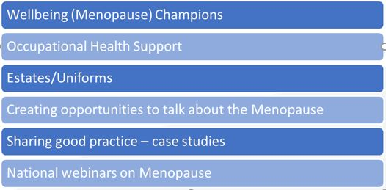
NHS Workforce Menopause Guidance Support Offer
(is there something you could tap into?)

Slide 21
Research Priorities
New NIHR research into Menopause is planned, including –
What is the cost of menopause to individuals (e.g. progression, pay, pensions), employers, the public sector (lost tax and benefit payments), and economy as a whole?
What is the relationship between perimenopause and menopause and mental health and depression?
What are the demographic variations in age of menopause onset and severity of symptoms?
These will inform further enhancements to workplace support best practice, including motivation for employers
E.g., Productivity and effectiveness gains, retention of senior and/ or experienced workforce, employee Health and Wellbeing

Slide 22
Thank you!

